Slide 1
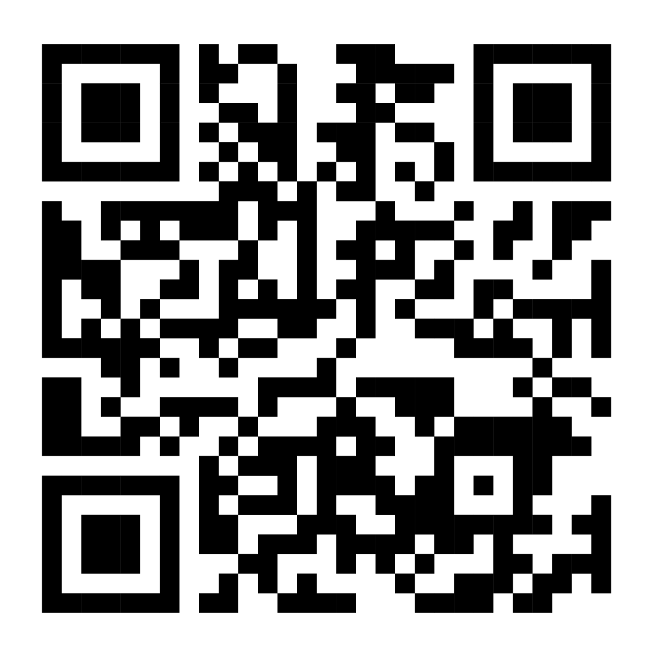
FORK-TO-FARM AGENT-BASED SIMULATION TOOL AUGMENTING BIODIVERSITY IN THE AGRI-FOOD VALUE CHAIN
Author(s), Affiliation, Address
ENTITY
LOGO HERE
EVENT
LOGO HERE
info@biovalue-project.eu
#BIOVALUE
www.biovalue-project.eu
The BioValue project has received funding from the European Union’s Horizon 2020 research and innovation programme under the Grant Agreement No. 101000499. The material presented and views expressed here are the responsibility of the author(s) only. Funding scheme: H2020-SFS-2020-2

